Slide 1

E+R=O
14 Day Challenge

Slide 2

“If I were to take 5% more responsibility for my _____, I would ______.”

Slide 3
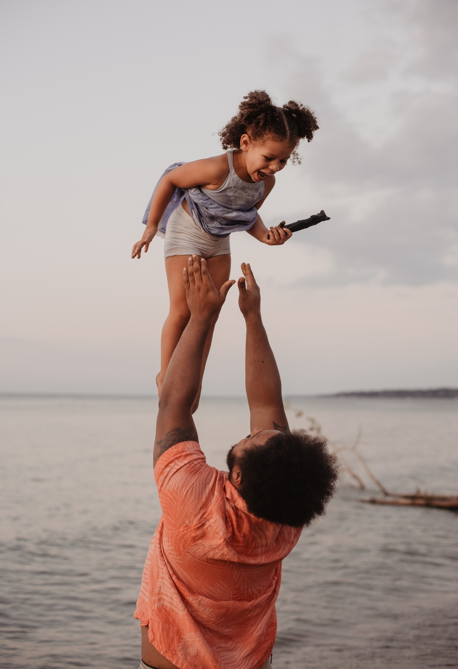
Event: ______________
Old Response: ______
Old Outcome: ______
Event: ______________
New Response: ______
New Outcome: _____

Slide 4


What your biggest insight or awareness has been so far.
How you will be more proactive with your responses?
One way you have created a new outcome or what outcome you hope to create.

Slide 5

What has your reaction or response been in the past, and what new response will you practice
in the future?

Slide 6

“I will commit to taking 5% more responsibility for my health, wellness, and fitness by _____”

Slide 7
On a scale of 1 to 10 (10 being the highest probability), how likely are you to follow through on your action steps to create the outcome you want?
Did you have any new insights or awarenesses from this exercise? If so, what were they?
If you are willing to share your difficult or troubling situation or the action steps you are going to take to resolve it, please do!

Slide 8

How are you feeling after a week of implementing
E+R=O

Slide 9
Tell us about an event from the last week.
I’m looking for an event that you consciously controlled your response to and created an outcome you might not have created before you learned about E+R=O.

Slide 10

“I will commit to taking 5% more responsibility for my career & business goals by _____”

Slide 11

Blaming and complaining can act as our 100%
Responsibility GPS
system.

Slide 12
What did you notice since completing the blaming and complaining section of the workbook?
Did you pay attention to all the situations where you caught yourself complaining and blaming?

Slide 13

What are you pretending not to know?
What is the cost of not taking action?
  What action will you take to control your outcome?

Slide 14

In the comments below, share with us three or more ways you will take 5% more responsibility for your personal growth goals.
  Bonus points if you share your current goals!

Slide 15

What big dream, goal, or vision are you ready to make real?
How will you take 100% responsibility for creating that outcome?

